Slide 1
Cryptography & Network Security
Ms. Regina Esi Turkson (Mrs Regina Esi Segbefia)
Department of Computer Science and Information Technology University of Cape Coast

Slide 2
Disclaimer!
The lecture slides are partially collected from the Internet for educational purpose only. The lecturer does not claim any credit for them and the copyrights belong to the original authors.

Slide 3
Cryptography and Network Security
Chapter 2
Foundations of Cryptography

Slide 4

Secure Communication Model
Oscar
Alice
Bob
x
y
Encrypt
Decrypt
K
K
Secret Key
Secret Channel
K

Slide 5
The Strength of the Cryptosystem
The strength of an encryption method comes from the algorithm, the secrecy of the key, the length of the key, the initialization vectors and how they all work together in the cryptosystem.
If a key can be broken by a Pentium IV processor in 3 hours, then the cipher is not strong at all. If they however be broken by multiprocessor system over 1.2 million years, then its pretty darn strong.

Slide 6
Cyptosystem Services
Confidentiality – Only authorized entities are allowed to view
Integrity – Ensures the message was not altered by unauthorized individuals
Authenticity – Validates the source of a message, to ensure the sender is properly identified

Slide 7
Cyptosystem Services
Nonrepudiation – Establishes sender identity so that the entity cannot deny having sent the message
Access Control – Access to an object requires access to the associated crypto keys in many systems (e.g. login)

Slide 8
Cyptosystem Services
Suppose your boss sends you a message telling you will be receiving a raise that doubles your salary.
The message is encrypted , so you will be sure it really came from your boss(authenticity).
So you will be sure that someone did not alter it before it arrived at your computer (integrity).
So you will be sure that no one read it as it travelled over the network (confidentiality).

Slide 9
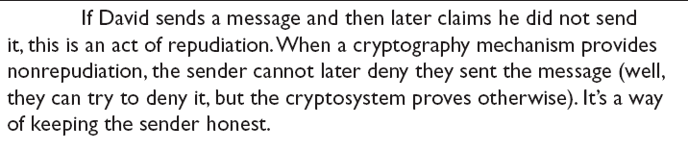
Cyptosystem Services
So that your boss cannot deny that he sent it when he comes to his senses (nonrepudiation).

Slide 10
Methods of Encryption
Symmetric/private/secret/single key
Same key for encryption and decryption
Key distribution problem
Asymmetric / Public key
Mathematically related key pairs for encryption and decryption
Public and private keys

Slide 11
Symmetric Cryptography: Examples.
Shift
Data Encryption Standard (DES)
Triple-DES (3DES)
Blowfish
IDEA
RC4, RC5 and RC6
Advanced Encryption Standard ( AES)

Slide 12

Examples:
So “security” will be encrypted as “hvxfirgb”
This is an example of a substitution cipher.
Specifically it is a monoalphabetic substitution cipher. We also have polyalphabetic

Slide 13
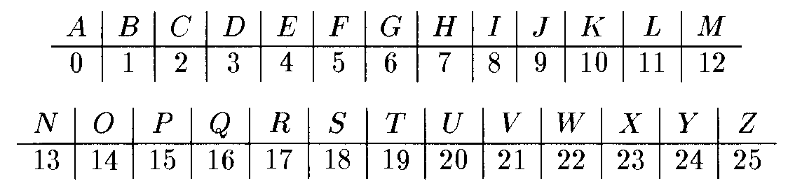
Shift Cipher
P=C=K=Z₂₆.
Encrypt：E_{k}(x)=x+k mod 26
Decrypt：D_{k}(c)=c-k mod 26
Plaintext
WEAREINCRYPTOCLASS.
+10
=Ciphertext
GOKBOSXMBIZDYMWCC
-10
WEAREINCRYPTOCLASS
=Plaintext

Slide 14
Is the shift cipher secure?
No -- only 26 possible keys!
• Given a ciphertext, try decrypting with every possible key
• If ciphertext is long enough (and plaintext is normal
English), only one possibility will “make sense”

Slide 15
Example
Ciphertext uryybjbeyq
Try every possible key…
• tqxxaiadxp
• spwwzhzcwo
• …
• helloworld

Slide 16
Kerckhoffs’s principle
The encryption scheme is not secret
• The only secret is the key
• The key must be chosen at random, kept secret
Some arguments in favor of this principle
• Easier to keep secret key than secret algorithm
• Easier to change key than to change algorithm
• Standardization
• Ease of deployment
• Public validation

Slide 17
Sufficient key space principle
The key space should be large enough to prevent
“brute-force,” exhaustive-search attacks
If an encryption scheme has a key space that is too small, then it will be vulnerable to exhaustive- search attacks

Slide 18

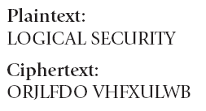
Caesar Cipher
Caesar – Shift all letters by a given number of letters in the alphabet

Slide 19
The Vigenère cipher
Vigenère – Use of a key and multiple (polyalphabetic cipher) alphabets to hide repeated characters in an encrypted message
The key is now a string, not just a character. To encrypt, shift each character in the plaintext by the amount dictated by the next character of the key
Wrap around in the key as needed
Decryption just reverses the process

Slide 20
Example
tellhimaboutme
cafecafecafeca ------------------------ veqpjiredozxoe
While Caesar has one shift alphabet, Vigenere uses 27 shift alphabets (Vigenere Table).

Slide 21
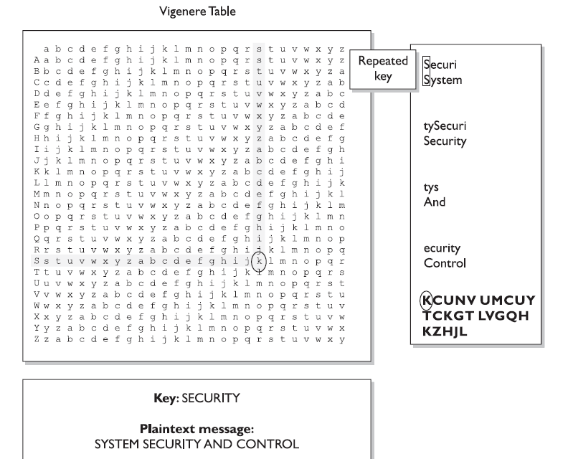
Vignère – Use of a key and multiple alphabets to hide repeated characters in an encrypted message

Slide 22
One-Time Pad
A one-time pad is a perfect encryption scheme because it is considered unbreakable if implemented properly.
It was invented by Gilbert Vernam in 1917, so sometimes it is refered to as Vernam Cipher.
The encryption process uses binary mathematical function called the exclusive-OR, denoted as XOR.

Slide 23
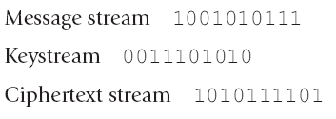
One-Time Pad
When combining two bits, if both values are the same, the result is zero (1 XOR 1 = 0). If the bits are different from each other the result is 1 (1 XOR 0= 1)

Slide 24
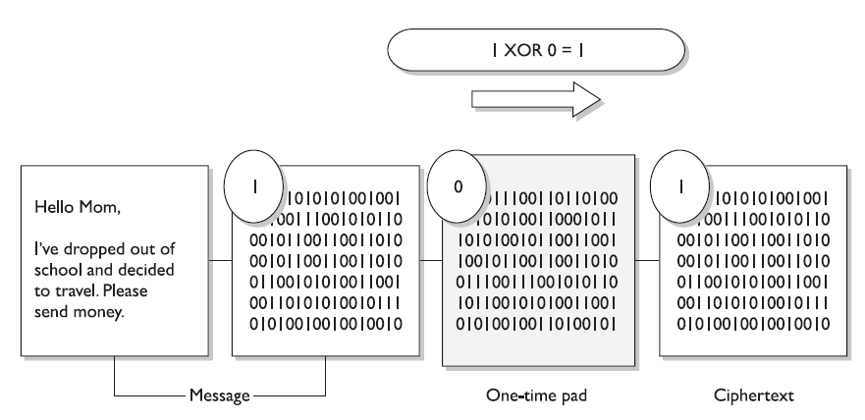
One-Time Pad-Encryption

Slide 25
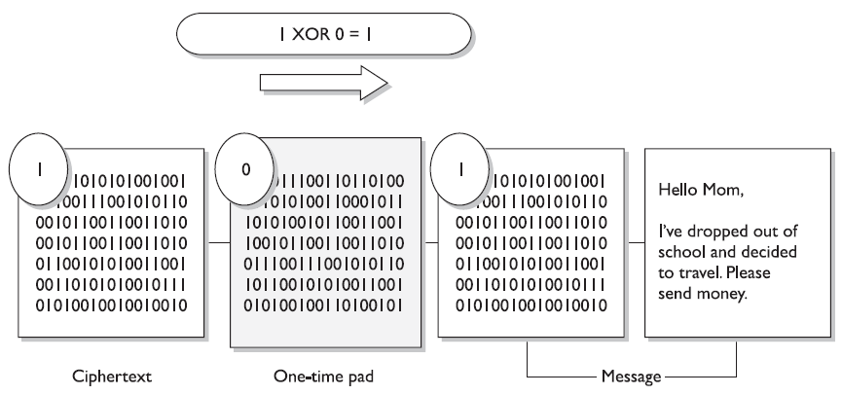
One-Time Pad-Decryption

Slide 26
One-Time Pad Requirments
The one-time pad encryption scheme is deem unbreakable if the following is true about the encryption process.
The pad must be only one-time.
The pad must be as long as the message.
The pad must be securely distributed and protected at its destination.
The pad must be made up of truly random values.

Slide 27
Data Encryption Standard(DES)
The Data Encryption Standard (DES) is a symmetric-key block cipher published by the National Institute of Standards and Technology (NIST).
The encryption process is made of two permutations (P-boxes), which we call initial and final permutations, and sixteen Feistel rounds.

Slide 28
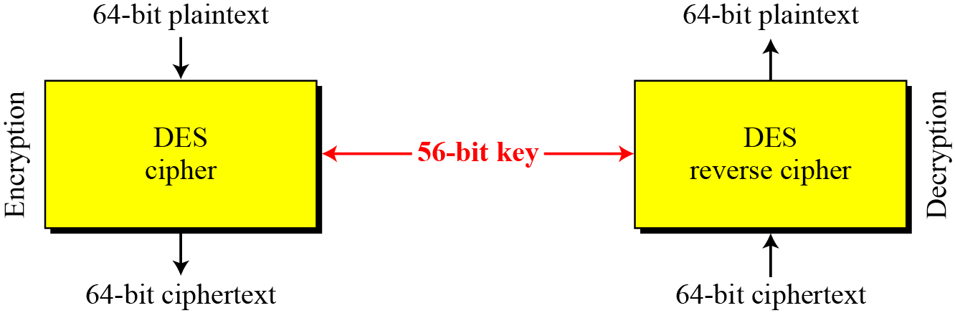
DES is a block cipher, as shown in the following Figure

Slide 29
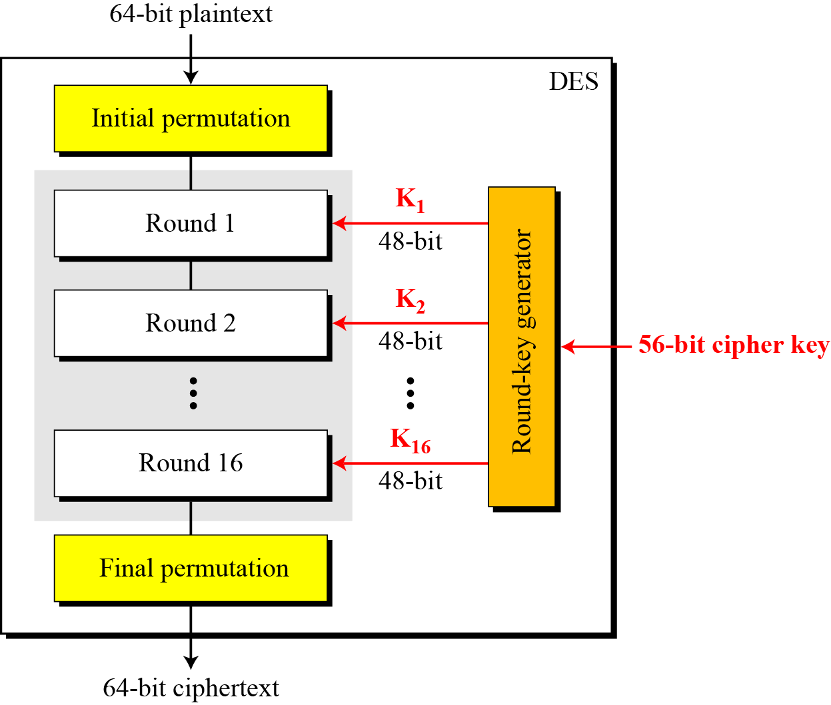
General structure of DES

Slide 30
Advanced Encryption Standard ( AES)
A replacement for DES was needed
Key size is too small
Private key symmetric block cipher
128-bit data, 128/192/256-bit keys
Notes:
The Advanced Encryption Standard (AES) was published by NIST (National Institute of Standards and Technology) in 2001. AES is a symmetric block cipher that is intended to replace DES as the approved standard for a wide range of applications. The AES cipher (& other candidates) form the latest generation of block ciphers, and now we see a significant increase in the block size - from the old standard of 64-bits up to 128-bits; and keys from 128 to 256-bits. In part this has been driven by the public demonstrations of exhaustive key searches of DES. Whilst triple-DES is regarded as secure and well understood, it is slow, especially in s/w. In a first round of evaluation, 15 proposed algorithms were accepted. A second round narrowed the field to 5 algorithms. NIST completed its evaluation process and published a final standard (FIPS PUB 197) in November of 2001. NIST selected Rijndael as the proposed AES algorithm. The two researchers who developed and submitted Rijndael for the AES are both cryptographers from Belgium: Dr. Joan Daemen and Dr.Vincent Rijmen.

Slide 31
AES Conceptual Scheme
Plaintext (128 bits)
AES
Key (128-256 bits)
Ciphertext (128 bits)

Slide 32
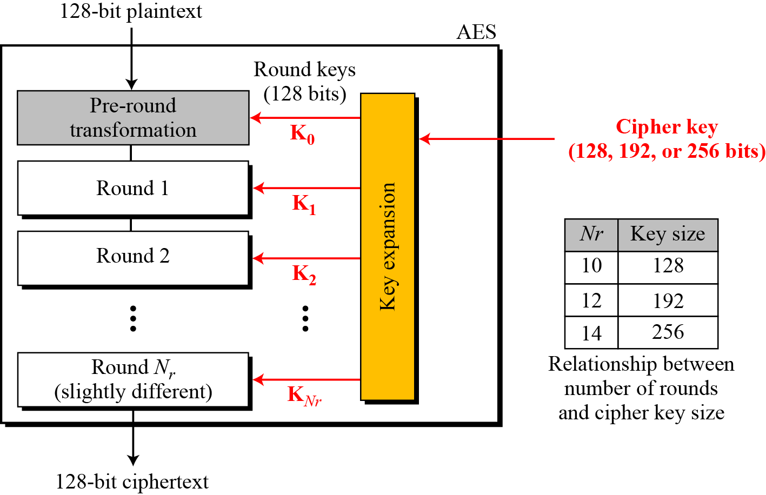
Multiple rounds
Rounds are (almost) identical
First and last round are a little different
Notes:
The input to the AES encryption and decryption algorithms is a single 128-bit block, depicted in FIPS PUB 197, as a square matrix of bytes .This block is copied into the State array, which is modified at each stage of encryption or decryption. After the final stage, State is copied to an output.
The key is expanded into 44/52/60 lots of 32-bit words (see later), with 4 used in each round.
The data computation then consists of an “add round key” step, then 9/11/13 rounds with all 4 steps, and a final 10th/12th/14th step of byte subs + mix cols + add round key. This can be viewed as alternating XOR key & scramble data bytes operations. All of the steps are easily reversed, and can be efficiently implemented using XOR’s & table lookups.

Slide 33
AES Competition Requirements
Stronger & faster than Triple-DES
Provide full specification & design details
Both C & Java implementations
Notes:
Listed above are NIST’s requirements for the AES candidate submissions. These criteria span the range of concerns for the practical application of modern symmetric block ciphers.

Slide 34
Types of Cipher
Substitution Cipher replaces bits, characters and blocks with different bits characters or blocks.
It uses key to dictate how the substitution should be carried out. In Caesar cipher, each letter is replaced with the letter three places beyond it in the alphabet. So the key is the instruction ‘Shift up three letters’.

Slide 35
Types of Cipher
Transposition Cipher : In transposition cipher, the values are scrambled, or put in different order.
The key determines the positions the values are moved to.
When implemented with complex mathematical functions, transposition can become quite sophisticated and difficult to break.

Slide 36
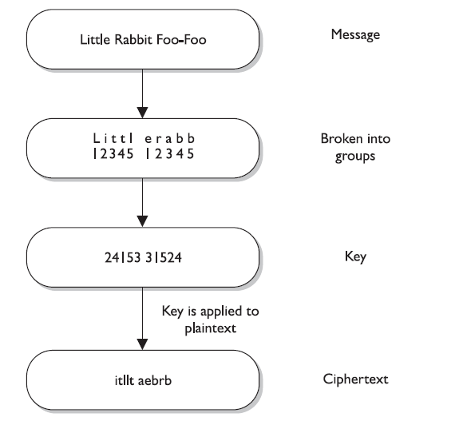

Slide 37
Substitution and Transposition
Symmetric algorithm employed today use both long sequence of complicated substitutions and transpositions on messages
The algorithm contains the possible ways that substitution and transposition processes can take place (represented in mathematical formulas).
The key is used as instruction for the algorithm, dictating exactly how these processes will happen and in what order.

Slide 38
Can we prove that some encryption scheme is secure?
First need to define what we mean by “secure” in the first place…

Slide 39
Cryptography
Characterize cryptographic system by:
type of encryption operations used
- substitution / transposition / product
number of keys used
- single-key or private / two-key or public
way in which plaintext is processed
- block cipher, in/out is one block of elements
- stream cipher, in/out is one continuous element

Slide 40
Cryptanalysis
Objective is to recover key not just message
General approaches:
Cryptanalytic attack
- rely on the nature of the algorithm
- plus general characteristics of the plaintext
- or some sample pairs of plaintext-ciphertext.
brute-force attack
- try every possible key

Slide 41
Cryptanalysis： Attacks
Goal： Compute the secret key k.
Ciphertext only attack： Given ciphertext C, find the secret key k, so that D_{k}(C) =M is the correct plaintext.
Known plaintext attack： Given C and its plaintext M, find the secret key k, so that D_{k}(C) =M.
Chosen plaintext attack： Attacker can choose any plaintext M，for which she can obtain the corresponding ciphertext C。Then，the attacker needs to find the secret key k, so that D_{k}(C) =M. Here the attacker may request many plaintext/ciphertext pairs. Notice that in the known plaintext attack, the attacker has no right to choose the plaintext of his choices. Here she might choose the plaintext so that the provided the ciphertext allow her to easily derive the secret key.

Slide 42
Chosen ciphertext attack： The attacker can choose any ciphertext C，then she can ask to get the corresponding plaintext M。Then, she is required to find the secret key k, so that D_{k}(C) =M. Here the attacker may ask many pairs ciphertext/plaintext.

Slide 43
More Definitions
unconditional security
no matter how much computer power or time is available, the cipher cannot be broken since the ciphertext provides insufficient information to uniquely determine the corresponding plaintext
computational security
given limited computing resources (eg time needed for calculations is greater than age of universe), the cipher cannot be broken

Slide 44
Brute Force Search
- always possible to simply try every key
- most basic attack, proportional to key size
- assume either know / recognise plaintext

Slide 45
Private-key cryptography
Private-key cryptography allows two users who share a secret key to establish a “secure channel”
The need to share a secret key incurs several
drawbacks…

